Slide 1
Predicting & minimizing customer churn

Slide 2
Project description
Current Level of Customer Churn: 18.5%
Analyze customer churn data and predict exiting customers
Develop a high-accuracy model to make predictions
Discover from the predictions market opportunities to reduce customer churn by 25%
Cost savings from reducing churn: 2.4 Million British Pounds
Proposed product will be deployed to customer service & Marketing divisions of HSBC Holdings Inc.

Slide 3
Project Scope
Goal: Reduce customer churn by 25%
Deliverables: Develop a high-accuracy model to make predictions
Major Milestones:
Choose a predictive algorithm
Develop a model
Discover market opportunities
Discover Market Segments
Develop plans for targeting segments

Slide 4
Preliminary model:
Developed in Automodel
Using the bank churn training dataset
The results show good initial performance on predicting churn
The model chosen: gradient boosted trees:
Less concern about:
Outliers, multi-colliniearity, normalization
Obtained 70% recall and 60% precision on predicting churn
Area Under Curve: 0.875
Can improve these figures with our own customized model?

Slide 5

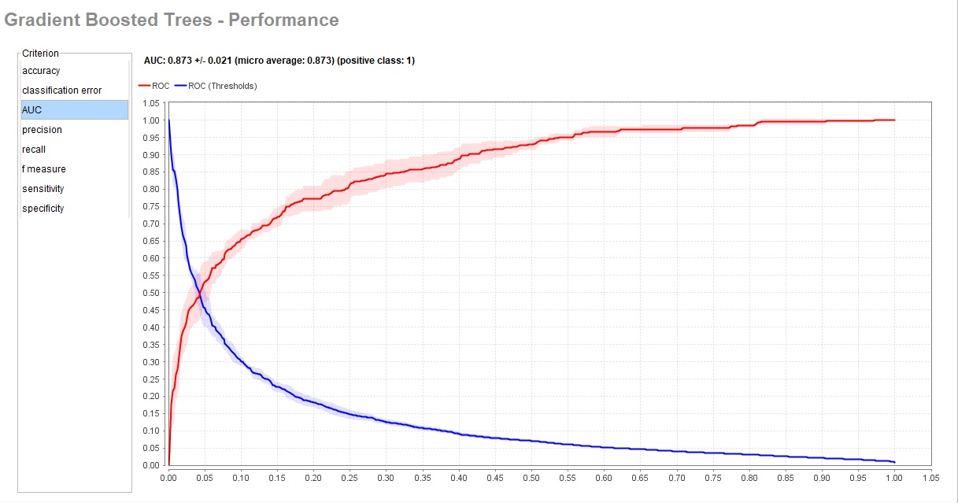
Area under curve for Gradient Boosted Trees: This was the best model for our purpose

Slide 6
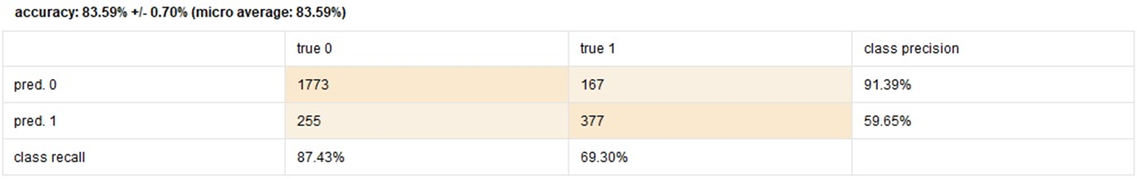
Performance of automodel gradient boosted trees:

Slide 7
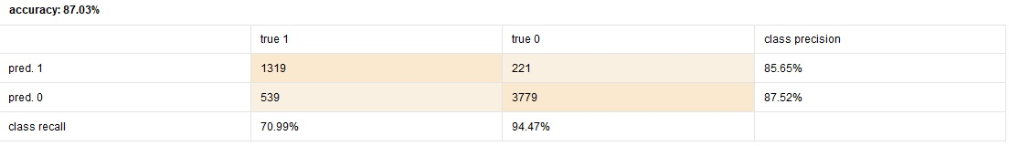
Results:
For our specific purpose I developed a customized model using Rapidminer.
The model performed well compared to Automodel

Slide 8
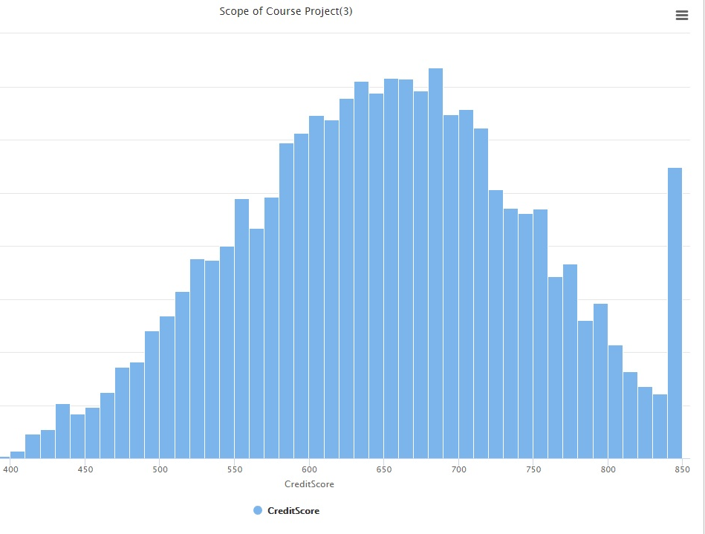
Distributions of feature data: credit score
Slight negative skew
Most customers have middle to lower credit scores?

Slide 9
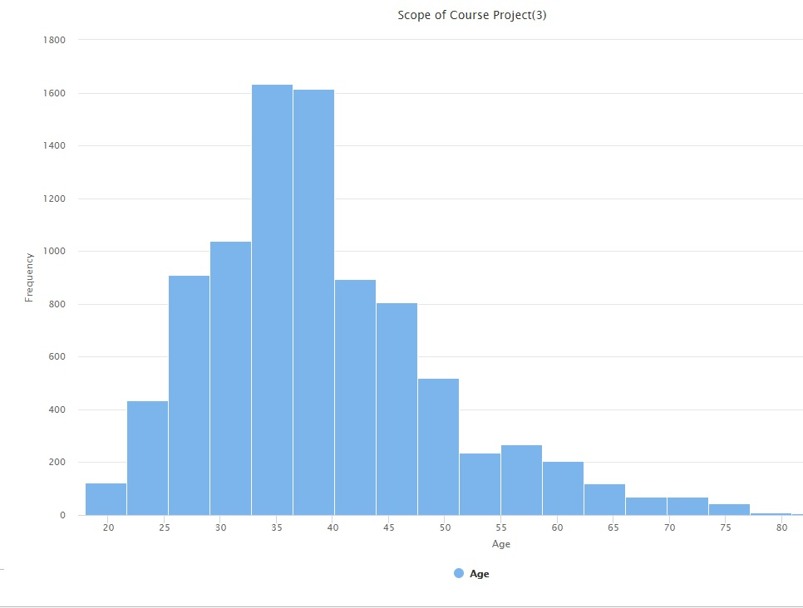
Distributions of feature data: age
Strong negative skew
Most customers are younger to middle-aged

Slide 10
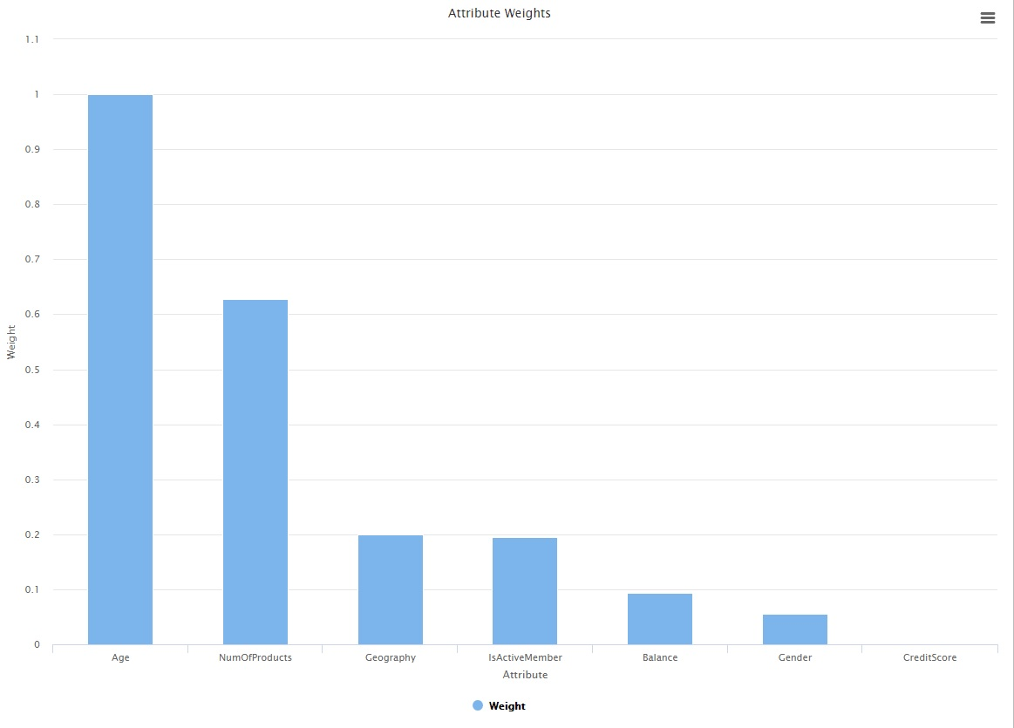
According to the model:
The most important variables towards influencing customer churn are:
Age
Number of products used at the bank
Geography / Whether or not they are active members

Slide 11
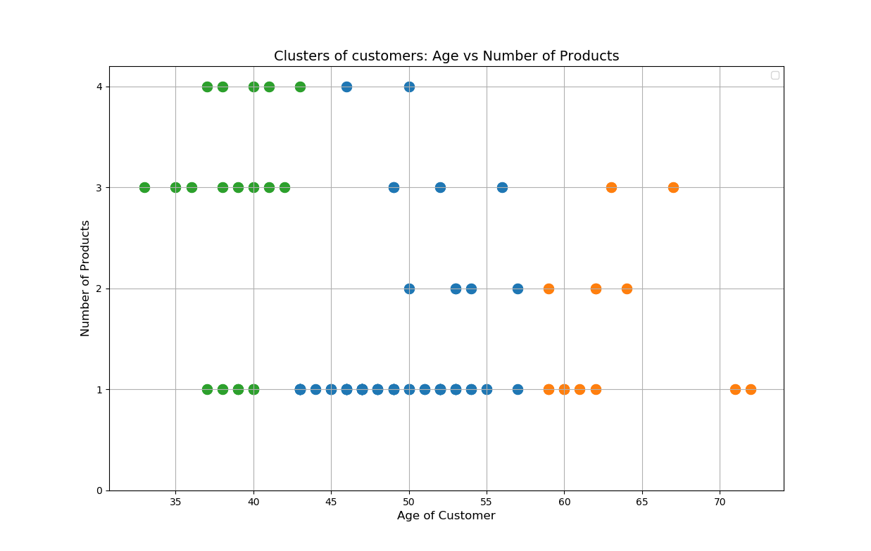
- Exploratory cluster visualization of customer age vs. number of products: - for 100 customers most likely to churn - Younger customers tend to have more banking products - More likely to have house / automobile loans? from hierarchical_cluster_mine_2.py

Slide 12
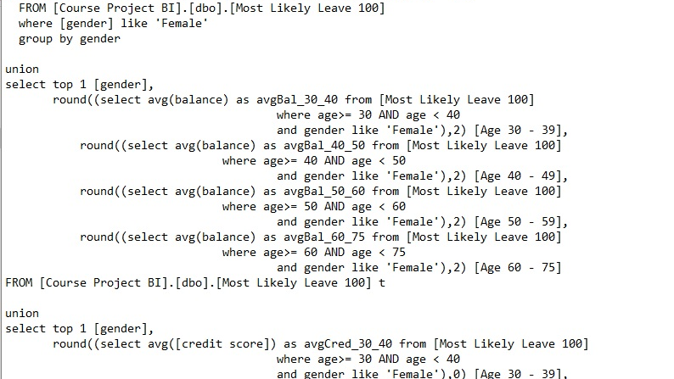
I Imported the dataset of 100 Customers most likely to leave into Microsoft Sql server
I used SQL code to gain insight into customers

Slide 13
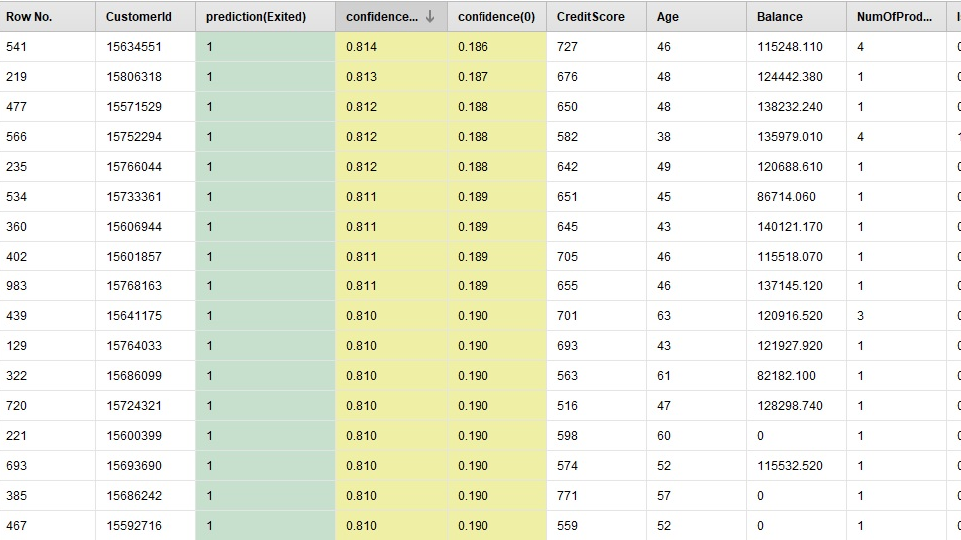
The model found:
The top 100 customers most likely to churn.
Of those customers, 19 most likely to exit are:
Women in Germany
Between ages 40 and 60
With only 1 banking product
Of these 19 customers, only half are active members
Recommendation: Cross-sell banking products to this group of customers & try to get them more involved in the management of their finances.
Age 40 - 50: Market savings accounts & managed investment accounts to this group
Age 50 - 60: Market managed investment accounts and retirement account services to this group
From Mostlikelychurn2.sql
A visualization of the 100 customers most likely to exit can be seen here:
Tableau Public

Slide 14
Breakdown of 100 customers most likely to leave from ChurnAggregate.sql
 | Ages: 30 - 39 | Ages: 40 - 49 | Ages: 50 - 59 | Ages: 60 - 75
Number Predicted: | 7 | 32 | 18 | 3 | Female
Avg. Credit Score: | 656 | 643 | 675 | 744 | Female
Avg. Balance: | 114399.49 | 77904.18 | 101440.16 | 98960.45 | Female
Number Predicted: | 4 | 15 | 13 | 8 | Male
Avg. Credit Score: | 646 | 622 | 613 | 661 | Male
Avg. Balance: | 88867.14 | 78565.11 | 102375.19 | 70986.86 | Male

Slide 15
Insights from table above: Profile of customers most likely to leave
60% of customers most likely to leave are females
females between the ages 40 and 60 are more likely to leave than males
Females have higher average credit scores
Females age 30 - 39 have much higher average account balances
Are very good customers to focus on for retention

Slide 16
The model found 184 customers predicted to churn: 18.4 % of the 1000 customers
27 of the 100 most likely to leave are males between age 40 and 60.
Most are between France and Germany
Out of this group, only 8 have more than 1 banking product
Cross-sell products to this group of customers in the form of savings accounts & automobile loans
Men are generally more comfortable doing their own investing in the stock market
Market investment accounts to this group of customers
Particularly for retirement accounts
Most people have little or no retirement savings & this could be an opportunity

Slide 17
Market segmentation of customers most likely to leave
Vast majority of these customers are located between France and Germany
Germany: 55
France: 32
Spain: 13
Some clusters have many customers predicted to exit located in France and Germany
Clusters with regards to geography can be viewed here in Tableau Public

Slide 18
Deploying the model to Europe Branches
This model can be used by all branches within Europe
The model will be exported from Rapidminer and saved to a secure Google cloud drive
The model can then be downloaded and utilized by all branches
If updates occur to the model, the updated version can be uploaded to Google drive
All branches can then download the new model version and put it to use

Slide 19
Development of the Rapidminer model used for the predictions

Slide 20
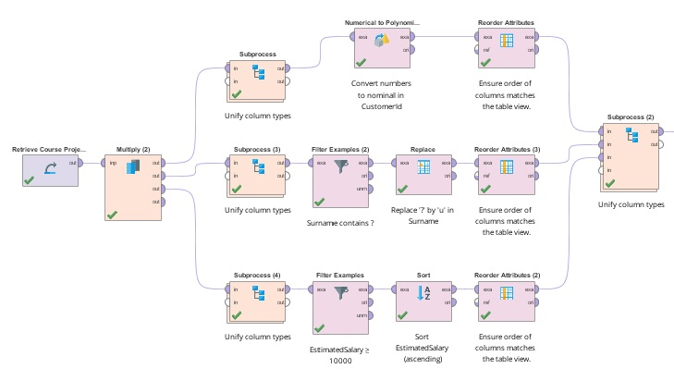
I developed my own model using Rapidminer
To improve upon the recall and precision results obtained in automodel
I also used Gradient Boosted Trees
I first cleaned and prepped the training data
Split the data using multiply
Combined prepped data using Subprocess

Slide 21
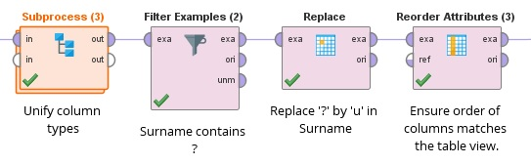
Data quality: found many surnames containing question marks (?)
Cleaned up the question marks and replaced them with the letter ‘u’.
Created the process shown above using Turboprep

Slide 22
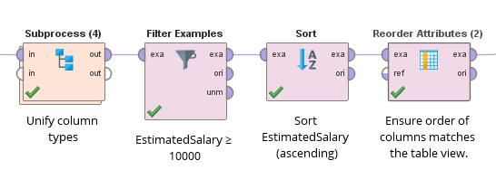
Data quality: found many salaries less than $5,000
Many had high bank account values.
Seemed strange so I deleted the data
Even if they were retired, income would still be streaming into accounts
Income would count as salary

Slide 23
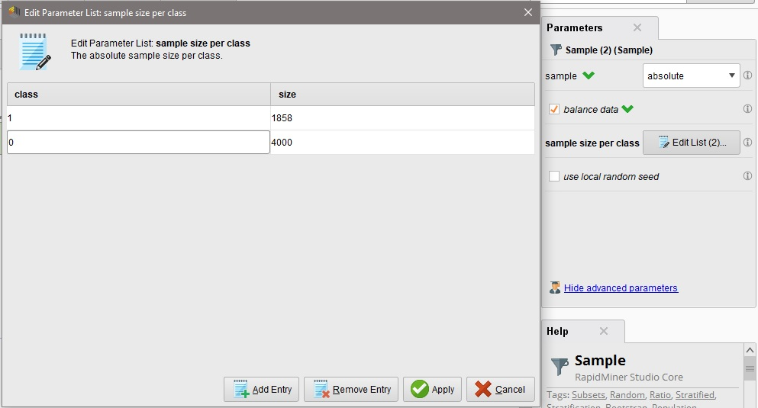
The exited feature was very unbalanced
Far more 0’s than 1’s.
Used the sample operator to balance input.
1858 1’s and 7243 0’s in the dataset
Detect outliers operator was used to find outliers

Slide 24
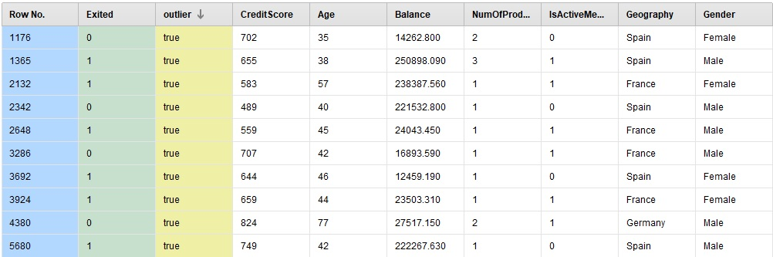
Outliers found in the data: The outliers did not seem problematic, so they were not left out of model.

Slide 25
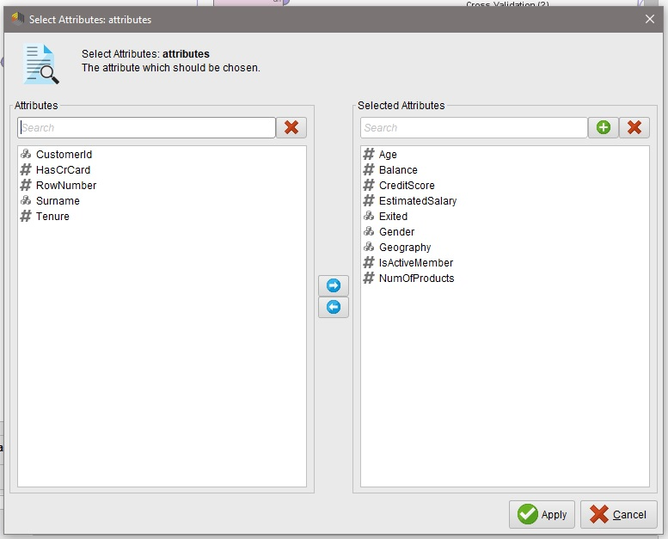
Selecting features for model
Features shown as selected attributes have most weight (importance) towards predicting churn with this model.

Slide 26
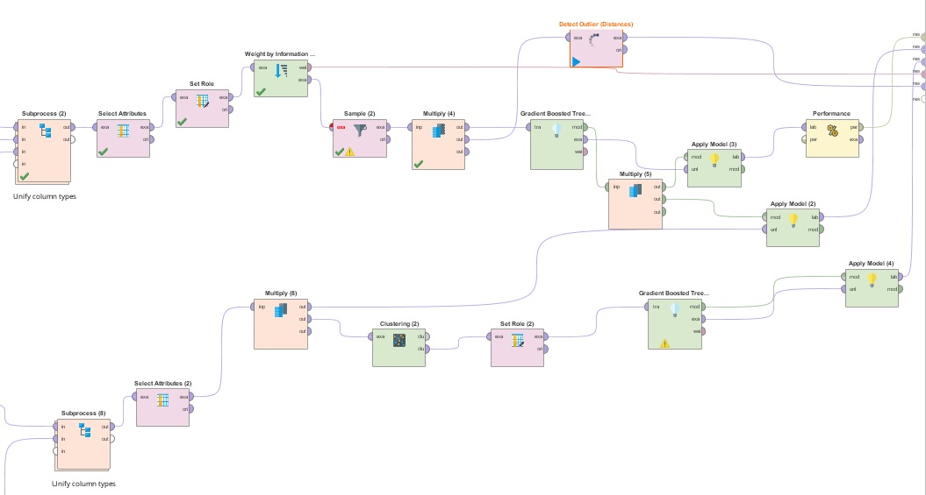
I then selected attributes….
Set Role to “Exited”
Sampled 4000 0’s & 1858 1’s
Balanced the data
Detected Outliers
Measured Performance
Used Gradient Boosted Trees for exit prediction and cluster prediction
Applied the model to new unlabeled data
Used K-Means Clustering to segment customers using Label as role

Slide 27
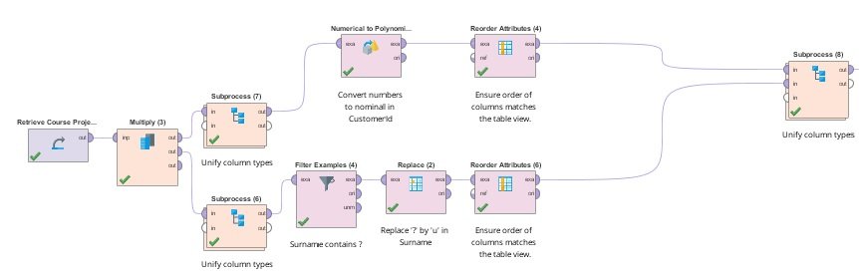
Prepped the production data…

Slide 28
Additional Information and code can be found at the following Github Account:
https://github.com/thomasawolff/Business-Intelligence-Course-Project
Thank you

